Slide 1

VEIN
BE A LIFE SAFER

Slide 2

Presented By:
Aryan Gupta
Aryan
Arpit Tyagi
Sandeep

Slide 3
Abstract
Introduction
Content
Project Analysis
Project Progress Evaluation
Future Scope

Slide 4
Abstract
The VEIN is a web application that allows users to find the blood camp location where blood is easily available.
Also, the blood bank user add their data that how much blood is available there.

Slide 5
Introduction
The VEIN is a web application that allows users to find the blood camp location where blood is easily available and also the blood bank user provide their data that how much blood is available there.
The main aim of this project is to resolve the problem which is faced by the user , so this system will help the users to find the blood in more efficient way .

Slide 6
Project Analysis
Objective:
Provide a platform where user can easily find the blood bank locations.
Problem:
The problem of needing blood on an urgent basis requires a coordinated effort from blood banks.
Solution:
VEIN is a platform on which user can easily find the location where blood is available.

Slide 7
OBJECTIVES
The objective of a VEIN website is to provide an easy-to-use online platform where users can search for blood banks in their local area or beyond. The website aims to connect blood donors with the nearest blood bank locations and provide users with the necessary information to donate blood or receive blood transfusions.
Some of the key objectives of a VEIN website may include:
Helping to address the shortage of blood donations by making it easier for donors to find nearby blood banks.
Providing information on the eligibility requirements for donating blood and the donation process to encourage more people to donate.
Providing information on the different blood types and their compatibility to ensure that patients receive the appropriate blood transfusion.
Encouraging community involvement in blood donation by providing information on volunteering at blood banks or organizing blood drives.

Slide 8
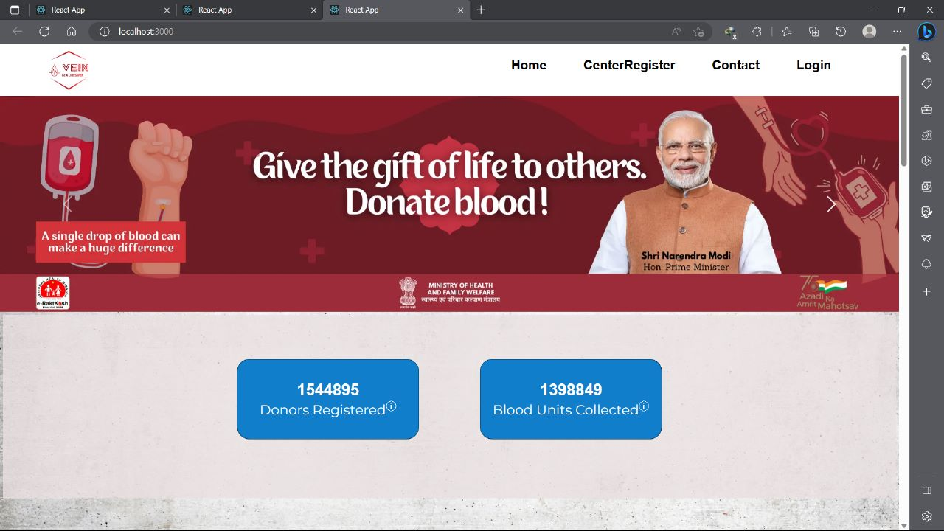
Home Page:

Slide 9
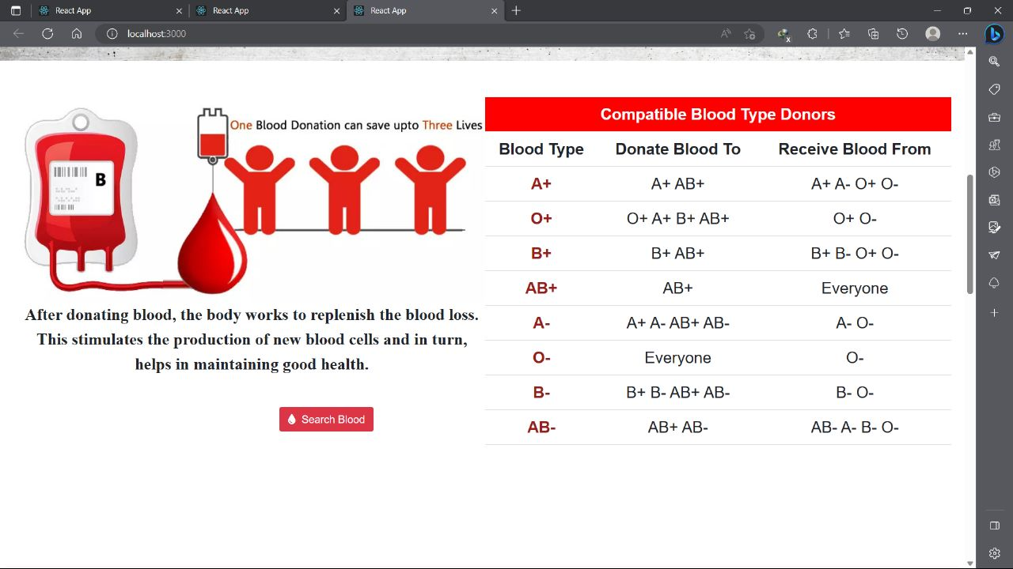

Slide 10
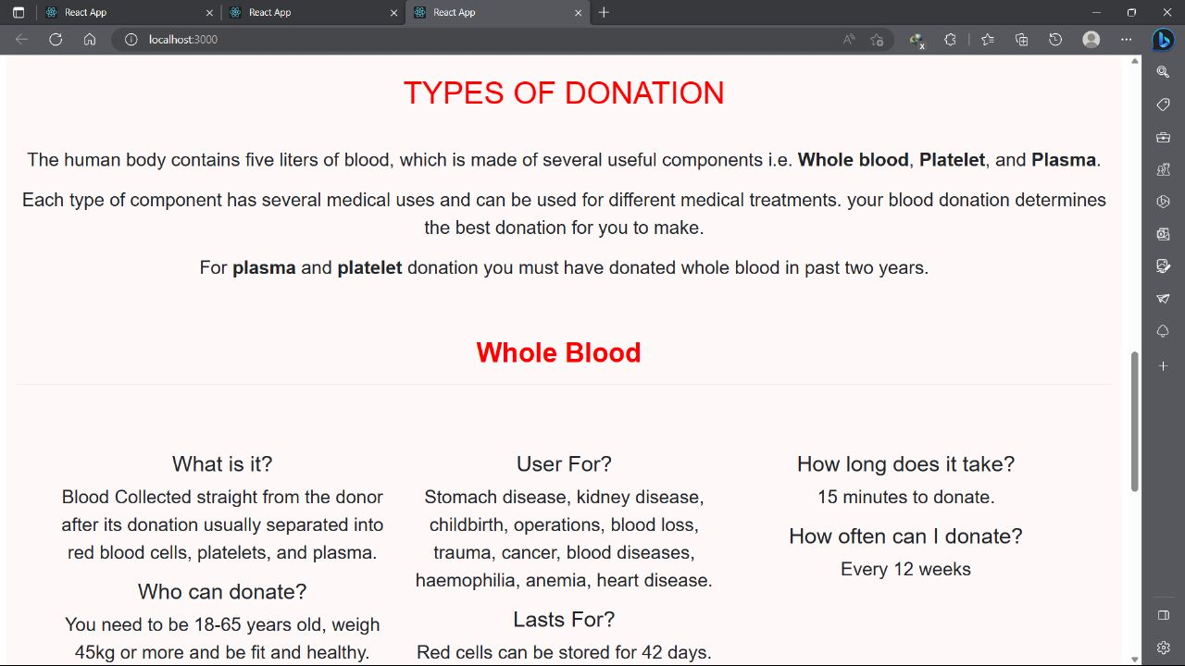

Slide 11
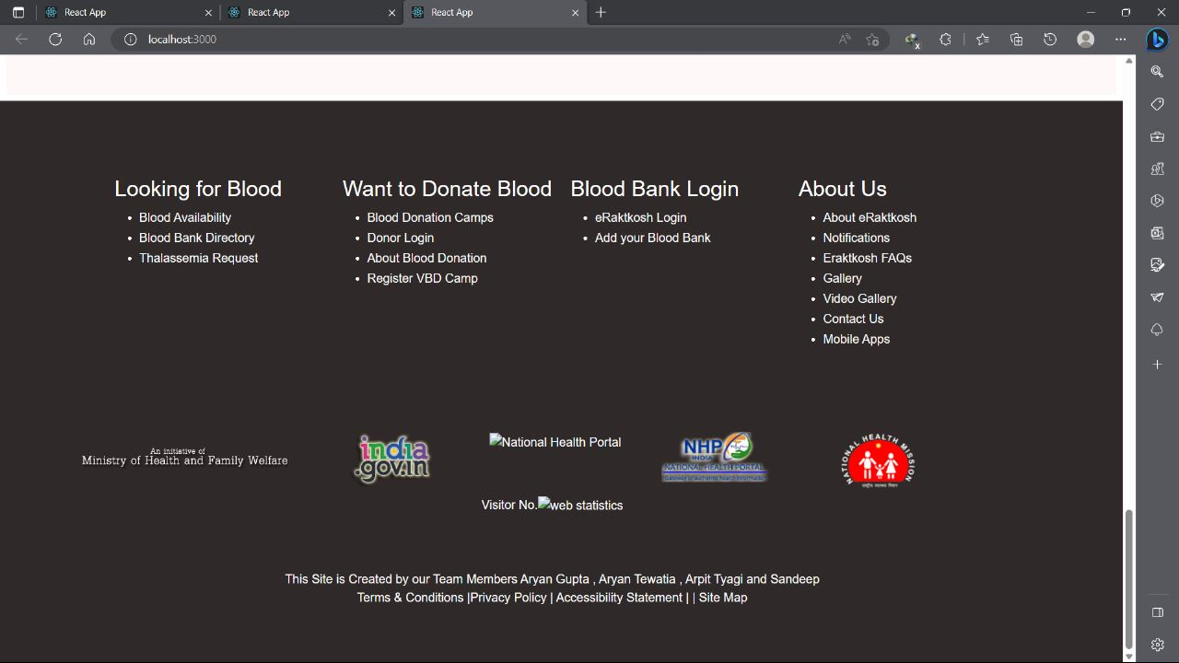

Slide 12
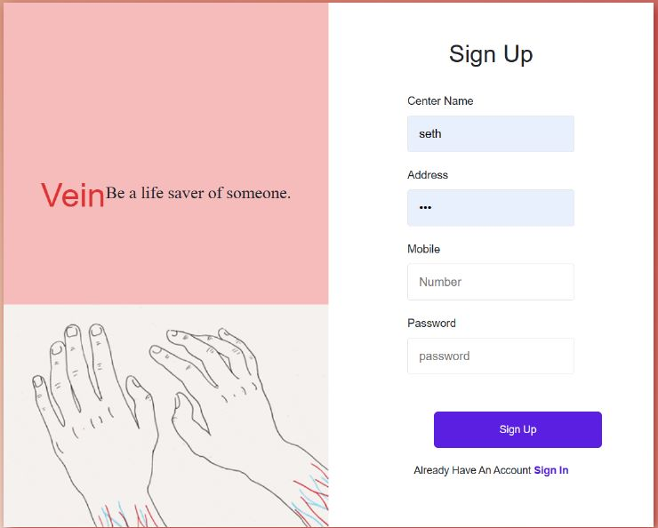
Registration Form
Any users can create an account by registering. The system will validate the user email and will reject them if they are missing or if the user email is already taken.
Customer fill all the details and clicks register.
System validates email and password fields.
System authorizes the user and create his account.
System confirms customer with email and phone authentication.
System sends confirming email to customer.

Slide 13
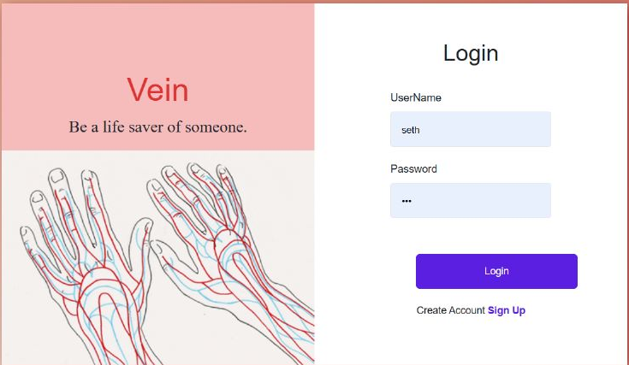
Login page
Login Page consist of username
and password.
Customer have to give username
and password to login.
System validates the details.

Slide 14
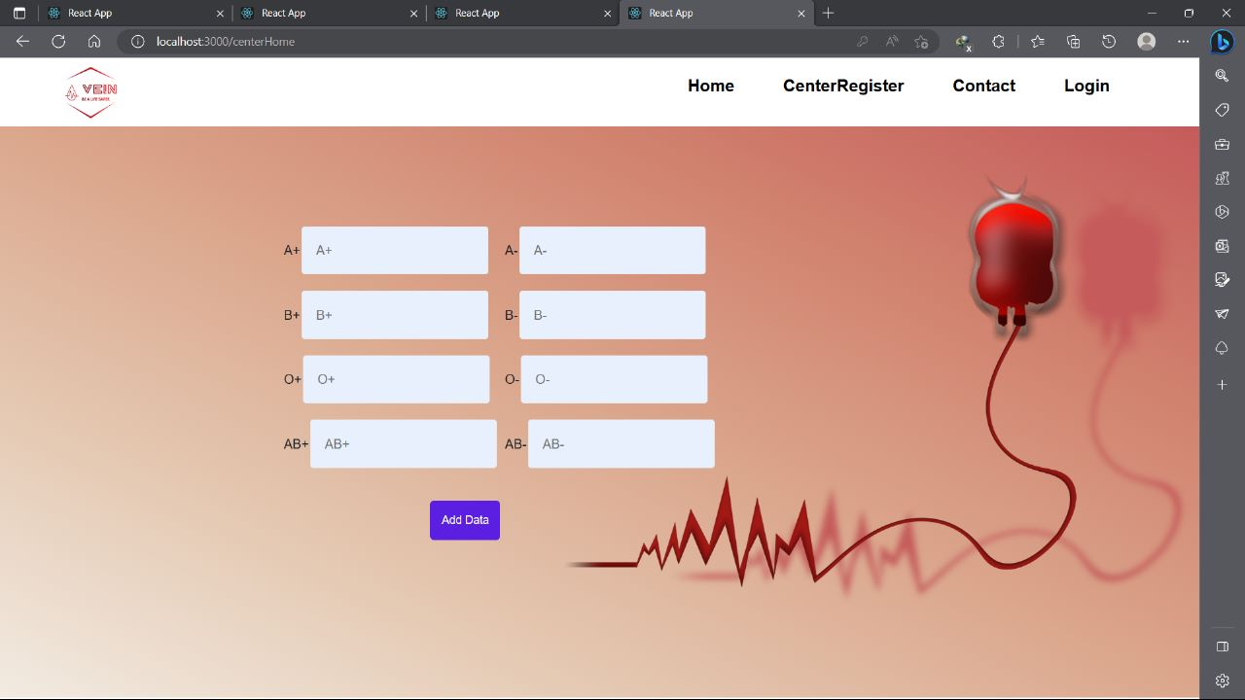
Blood Bank User Interface:
Here user can add their data in
terms of blood group that
how much blood is available.

Slide 15
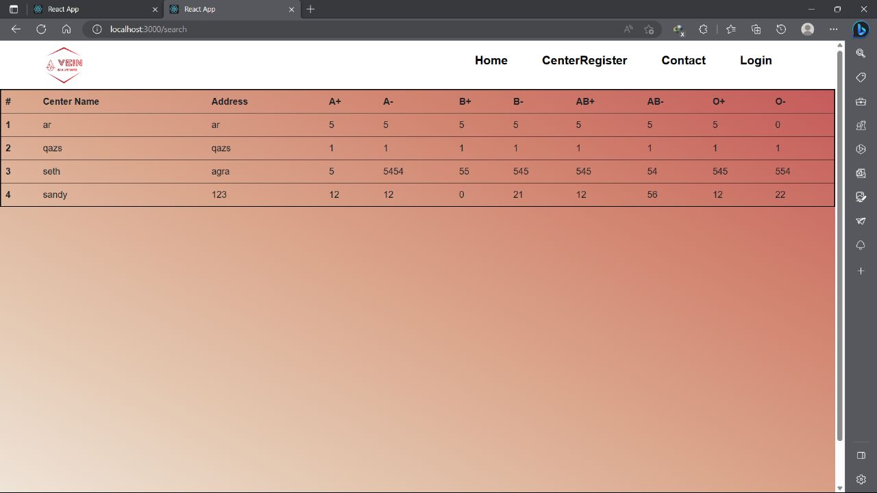
CenterRegister:

Slide 16
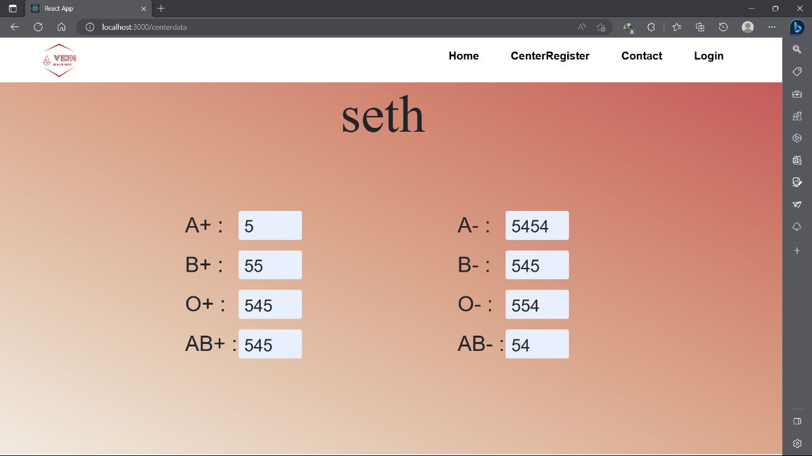
CenterRegister:

Slide 17
Programming Languages Used
HTML : HTML stands for Hypertext Mark-up Language . It used for mainly to display text code as well as formatting these texts.
CSS: CSS stand for Cascading Style sheets. This is a very powerful language for formatting the web pages and has been of great help in my project.
JavaScript is a scripting language that enables you to create dynamically updating content, control multimedia, animate images, and pretty much everything else.
The React.js framework is an open-source JavaScript framework and library developed by Facebook. It's used for building interactive user interfaces and web applications quickly and efficiently with significantly less code than you would with vanilla JavaScript.
MongoDB : MongoDB is a popular NoSQL document-oriented database that provides high scalability, flexibility, and performance for modern applications.

Slide 18
Future Plans
The future scope of a blood bank finder website could include:
Expanding coverage: The website could expand its coverage to include more regions and countries, making it easier for people all over the world to find blood banks near them.
Integrating with mobile apps: The website could integrate with mobile apps to make it more accessible to users on-the-go, and to provide real-time information about blood bank locations and availability.
Partnering with hospitals and blood banks: The website could partner with hospitals and blood banks to provide more accurate and up-to-date information about blood availability and donation drives.

Slide 19
Additional Future Plans
Implementing donation scheduling: The website could implement a donation scheduling feature, allowing users to book appointments for blood donations and making it easier for blood banks to manage their inventory.
Incorporating blood type matching: The website could incorporate blood type matching functionality, allowing users to search for blood banks that have specific blood types available.
Adding a social media component: The website could add a social media component, allowing users to share their blood donation experiences and encouraging others to donate blood.
Overall, the future scope of a blood bank finder website is vast, and with continued innovation and development, it could become an indispensable tool in the effort to save lives through blood donation.

Slide 20
Conclusion
A VEIN website is an essential tool for individuals who require blood transfusions or those who wish to donate blood. This website can provide a user-friendly interface that allows users to easily find the nearest blood banks or blood donation centers. Additionally, the website can provide information on the availability of different blood types, operating hours, and contact information for blood banks. Overall, a blood bank finder website can be a valuable resource for both blood donors and recipients, helping to ensure that lifesaving blood transfusions are readily available when needed.

Slide 21
Thank You

